Slide 1
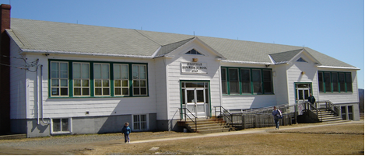
Sustainability Study of Millville Elementary School

Slide 2
Public Meeting #1 Agenda
Introductions
Review of Provincial Policy 409 Multi–Year School Infrastructure Planning
Presentation of Facts – Millville Elementary School
Question and Answer
What’s Next?
Online Resources and Feedback
Next Meetings

Slide 3
Provincial Policy 409: Multi-year School Infrastructure Planning
Outlines a number of responsibilities to do with facilities in our system
Sections 6.4, 6.5 and 6.6 are relevant for Sustainability Studies
Three Public Meetings
Meeting 1 – Presentation of Facts from District regarding School (Policy 409, 6.4.4 )
Meeting 2 - Presentation from Stakeholders regarding their thoughts on the sustainability of the school and relevant factors
Meeting 3 – Final Review of Information by District Education Council (DEC) and subsequent motion on next steps
Not Designed as an “Us-Against-Them” process; public meetings are not designed to facilitate debate between two parties
Three Possible Outcomes
Status Quo
Recommendation to Minister to repair the school
Recommendation to Minister for closure, moving the students elsewhere

Slide 4
Presentations of Facts
Enrolment
Quality of Education Programs & Services
Provincial Assessment Results & Student Perception Results
Health & Safety Building Assessment
Transportation
Finances
Impact on Other Schools
Economic Development
Impact on the Local Community

Slide 5
Enrolment Millville Elementary School

Slide 6
Enrolment by Grade Level
 | 2008 | 2009 | 2010 | 2011 | 2012 | 2013 | 2014 | 2015 Projected
K | 7 | 8 | 7 | 12 | 13 | 1 | 5 | 1
1 | 8 | 7 | 10 | 7 | 12 | 16 | 2 | 4
2 | 3 | 9 | 6 | 11 | 7 | 11 | 12 | 3
3 | 5 | 5 | 8 | 4 | 9 | 4 | 8 | 9
4 | 7 | 6 | 4 | 9 | 4 | 8 | 4 | 8
5 | 8 | 8 | 6 | 7 | 8 | 4 | 9 | 5
Total | 38 | 43 | 41 | 50 | 53 | 44 | 40 | 30
Notes:
K 2008-2013 : -3
K 2009 -2014: +1
K 2011- 2015: -5
1 2008-2012 : 0
1 2009-2013: -3
1 2010- 2014: -1

Slide 7
Projected Enrolment Millville Elementary School

Slide 8
Functional Capacity Millville Elementary School
Functional Capacity Data | Student Enrollment | Number of Classrooms | Classrooms in Use | School Capacity | Capacity Rating
Based on 24 Students per class | 40 | 4 | 3 | 96 | 41.7%
Notes:
Functional Capacity provides data regarding the usage of classrooms within our schools. It is based on all spaces in a school that could be used for “homerooms.” In order to determine “functional capacity,” rooms are assigned maximum size based on grade level. Resource rooms, libraries, gymnasiums, pools, theatres, cafeterias, industrial and home economics facilities are not included. Functional Capacity is relevant in that it allows comparison of space utilization on a school by school basis.
The “rating” system for each school is an expression of the percentage of the space occupied when comparing the student population to the capacity of the building.
Greater than 80% - Full Capacity
60% to 80% - Optimum
Less than 60% - Under Utilized
30% or less – Triggered for Sustainability Study

Slide 9
Quality of Education Programs and Services Millville Elementary (MES)
MES Educational Staff
The provincial staffing formula calls for:
Student Teacher Ratio Millville Elementary School
Full Time Equivalent (FTE) 2015-16 | Millville Elementary School
Classroom Teachers | 3.40 FTE
Administration | 0.4 FTE
Guidance | 0.00 FTE
Resource | 0.20 FTE
Total | 4.00 FTE
Year | Total Number Student : Ratio | Student : Teacher
2014-15 | 40 : 4.20 | 9.52 : 1
2015-16 | 29 : 4.00 | 7.25 : 1
Notes:
Remember this is 2015-16 staffing.

Slide 10
Support Staff Information
Full Time Equivalent (FTE) 2015-16 | Millville Elementary School
Educational Assistants | 0 hours per week (0.0 FTE)
Administrative Assistant | 36.25 hours per week (1.0 FTE)
School Library Worker 1 | 2.5 hours per week (0.06 FTE)
Custodian I | 26 hours per week (0.65 FTE)
Notes:
Remember this is 2015-16 staffing.

Slide 11
Millville Elementary School Student: Teacher Ratio 2014-15
School | Year | Total Number Student: Teacher | Student: Teacher
Millville Elementary | 2014 - 2015 | 40 : 4.20 | 9.52 : 1
McAdam Avenue Elementary | 2014 - 2015 | 83 : 6.80 | 12.20 : 1
Chipman Elementary | 2014 - 2015 | 104 : 8.0 | 13.00 : 1
Nackawic Elementary | 2014 - 2015 | 221 : 14.5 | 15.24 : 1

Slide 12
Class Size Comparisons 2014-2015
 | Minimum Class Size | Maximum Class Size | Average Class Size | Number of Classes 2014-15 | Number of Classes 2015-16
Millville Elementary School | 13 | 14 | 13 | 3 | Minimum class size - 8 Maximum class size - 12 Average class size – 10 3
McAdam Avenue Elementary School | 10 | 23 | 17 | 5 | 5
Chipman Elementary School | 14 | 21 | 17 | 6 | 7
Nackawic Elementary School | 15 | 25 | 20 | 11 | 12

Slide 13
Maximum class sizes
Grade Level | Maximum Number of Students
K-2 | 21
3 | 26
K-3 Combined Classes | 16
Grades 4-6 | 28
Grades 3 -5 Combined Classes | 23
Grades 7 to 12 | 29
Grades 5 to 12 Combined Classes | 24

Slide 14
Core Curriculum
 | Early French Immersion | Late French Immersion | Gymnasium | Music/Fine Arts Specialists | Educational Support Services | EST-Literacy | EST-Math | EST-Technology
Millville Elementary School | No | NA | No | Yes | Yes | Yes | Yes | Request Support
 | EST-French ImmersionI | EST Science | Science Labs | Computer Lab | Computer Aided Drafted Lab (CAD) | Middle Level Technology | Broad Based Technology | Skills Trade Area | Distance Learning
Millville Elementary School | No | Yes | No | Yes | NA | NA | NA | NA | NA

Slide 15
Quality of Education Programs and Service
Grade 5 Students from Millville Elementary School enter Nackawic Middle School for Prime or French Immersion Programs, beginning in Grade 6. This is the last year for the late French Immersion program at Nackawic Middle School.

Slide 16
Impact on Other Schools Update
Beyond a decision of status quo or a recommendation to fix/upgrade the school as it stands now, the following scenarios rise to the surface as possible considerations:
Movement of students from Millville Elementary School to Nackawic Elementary School.
Movement of students from Millville Elementary School to a newly created K-8 setting at the current Nackawic Middle School pending the outcome of the parallel sustainably study in Nackawic.
It does not seem reasonable to consider moves to Keswick Valley Memorial School, or Keswick Ridge School.

Slide 17
Two Scenarios
 | K-5 at Nackawic Elementary School | K-8 at Nackawic Middle School
Projected 2016-17 enrolment | 227 | 361
Projected 2016-17 number of homerooms | 11 | 18
Projected 2016-17 Functional Capacity | 72.8% | 77.1%
Projected 2016-17 Teacher FTE | 14.6 FTE | 24.5 FTE

Slide 18
Special Events That Encourage Community School Partnerships at Millville Elementary
Writers in Schools Program
Crabbe Mountain Season Ski passes given to all students
Disability Awareness Walk & Roll Challenge
Career Day
NB Choral Federation workshop with K-5 students and choir.
For a complete listing of community school partnerships please view the school’s annual report posted on the ASD-W sustainability site at www.asd-w.nbed.nb.ca and follow the sustainability links.

Slide 19
Student Voice
Tell Them From Me Survey
Co- creation of school chant with students
Organized Recess Clubs
Drama club has input into the play that they would like to perform as well as characters they would like to play
For a complete listing of opportunities for student voice please view the school’s annual report posted on the ASD-W sustainability site at www.asd-w.nbed.nb.ca and follow the sustainability links.

Slide 20
Provincial Assessment Results
Grade 2 Reading
Millville Elementary School
Grade 4 Reading
Millville Elementary School
Year | Millville Elementary | District | Province
2009-10 | 88.9% | 72.5% | 83.6%
2010-11 | 100.0% | 75.8% | 80.3%
2011-12 | 100.0% | 78.0% | 79.1%
2012-13 | 100.0% | 80.3% | 79.5%
2013-14 | 70.0% | 76.8% | 77.5%
Year | Millville Elementary | District | Province
2009-10 | 83.3% | 78.4% | 83.4%
2010-11 | 100.0% | 74.3% | 80.5%
2011-12 | 75.0% | 77.5% | 77.1%
Results not available after 2011-12 due to changes in the Provincial Assessment system.

Slide 21
Provincial Assessment Results
Grade 5 Numeracy Millville Elementary
Year | Millville Elementary | District | Province
2009-10 | 62.5% | 54.3% | 59.4%
2010-11 | 83.3% | 60.4% | 60.8%
2011-12 | 66.7% | 63.7% | 63.7%
2012-13 | 62.5% | 64.0% | 62.9%
*2013-14 | NA | 60.0% * | 59.4% *
* Based on a 20% sample of students.
21

Slide 22
Student Perception Data
Based on the 2014-15 Student Perception Survey Results Grades 4-5
64% of students reported that they feel accepted and valued by peers and others in the building, contributing to a positive sense of belonging. * Canadian norm is 86%.
71% of students reported that they feel safe attending their school. * Canadian norm is 69%.
86% of students reported that they value school outcomes and the importance of education to their future. * Canadian norm is 96%.
46% of students reported that they were interested and motivated in their learning. * Canadian norm is 74%.
For a complete review of the school based Tell Them From Me Report please visit the ASD-W sustainability site at www.asd-w.nbed.nb.ca and follow the sustainability links.

Slide 23
School Benefits
Strong knowledge of individual students, as well as their strengths and needs . This results in increased academic achievement and fewer student behaviors.
All students are active participants in school wide initiatives.
Smaller class settings create the opportunity for staff to provide one on one attention more readily.
Culture of collaboration is established among all staff.

Slide 24
School Challenges
Funding for educational staff is based on student enrolment. A smaller staff requires added supervision to individual work loads.
Funding for extra curricular activities is determined by student enrolment. Schools are required to fundraise in order to support the activities it hosts in support of educational experiences.

Slide 25
Millville Elementary School (MES) Facility General Information
The school was constructed with 4 classrooms.
Corridor and classroom walls are plaster.
Ceilings are original 12” x 12” tiles in good condition.
The building is equipped with appropriate fire alarm system and fire extinguishers are located throughout the building.

Slide 26
MES Bottom Floor

Slide 27
MES Top Floor

Slide 28
MES Building Summary
Constructed in 1949.
Renovations have included:
Oil fired boiler installed in 1998.
Original windows are in poor condition. Some of the windows were replaced in 2003, and 2005.

Slide 29
MES Building Systems
Electrical entrance is 200 amps, 120/240 volt and in good condition, with no additional capacity for more circuits.
Interior lighting is fluorescent and in fair condition.
The building has a Public Address system.

Slide 30
MES Building Systems Continued
School is heated by oil fired boilers and a new above ground oil tank has been installed.
The school is served with well water.
Attic insulation was added in 2013.

Slide 31
MES Interior
Washrooms are found to be in good condition, some fixtures are original.
Floors are tile in fair to good condition.

Slide 32
MES Exterior
Exterior doors are in good condition.
The exterior cladding is hard board siding in poor condition.
Parking is adequate (gravel in poor condition).
Exterior lighting is present.

Slide 33
MES Property
Staff and visitors share the school parking lot.
The driveway is shared by the bus loading zone and parent drop off.
Playground has a ball field, new basketball court(2014) and a couple of play structures.

Slide 34
MES Capital Investments
Year | Scope of Work | Cost
2009/2010 | Septic Field | $50,257.00
2013/2014 | Roof repairs | $15,620.00
2013/2014 | Oil tank replacement | $11,913.00
Total: $77,790.00

Slide 35
MES School Physical Plant Status
Building Exterior and Site |  | Description | Estimated Cost
Building Envelope | Roof Replacement | Peaked roof with Shingles
Building Envelope | Exterior | Siding replacement
Site | Site Improvement | Paving
Building Envelope | Windows | North side window replacement

Slide 36
MES School Physical Plant Status (continued)
Building Interior and Additions |  | Description | Estimated Cost
Interior accessibility | Lift | Wheel chair lift and automatic door openers
Interior | Flooring | Floor replacements.
Interior alterations and renovations | Office | Office relocation

Slide 37
MES School Physical Plant Status (continued)
Mechanical and Electrical Systems |  | Description | Estimated Cost
Electrical | Communications | Intercom system throughout school
Water supply and sewer | Water supply and distribution | Backflow prevention
Electrical | Electrical Supply and Distribution | Electrical upgrade (panels)
Heating and Ventilation | Ventilation System | Ventilation system and electrical upgrade
 |  | Total estimated cost | $836,900.00

Slide 38
Millville Transportation Study
Currently students in grades 6-12 and those enrolled in French Immersion in grades 3-5 that reside in the Millville Elementary School Catchment area are bused to the Nackawic Schools.
The morning school bus system currently sees three buses transport students within the Millville School Catchment area into the Millville Elementary School.

Slide 39
Millville Transportation Study
The afternoon school bus system currently sees two buses transport students residing within the Millville School Catchment.
There would not be any impact with regards to the number of school buses or drivers if the Millville Elementary School should close. However, there would be a reduction in kilometers travelled by the school buses.

Slide 40
Millville Transportation Study
School | Longest Ride In | Longest Ride Out | Earliest Pick-up | Latest Drop Off | Average Ride Time
Millville Elementary School | 42 mins | 27 mins | 7:11a.m. | 2:42p.m. | 14 mins

Slide 41
Current Student Address Distances
 | Distance to Millville Elementary School (KM) | Distance to Nackawic School (KM) (Scenario)
Average Distance | 4.3 | 20.4 (Average travel time 37 minutes)
Maximum Distance | 16.4 | 26.6 (Maximum travel time 45 minutes)
Minimum Distance | 0.4 | 16.9 (Minimum travel time 22 minutes)

Slide 42
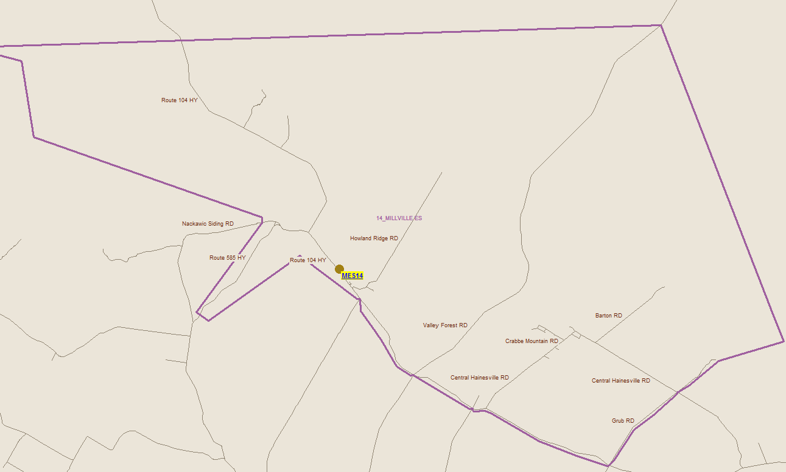
Millville Transportation Study

Slide 43
Salaries
 | Actual Costs
Cost Centers | Fiscal Year | Fiscal Year | Fiscal Year
 | 2014-2015 | 2013-2014 | 2012-2013
Salaries
Administration | 12,510 | 12,309 | 12,252
Teacher | 311,271 | 343,521 | 319,122
Admin. Assistant | 31,775 | 28,694 | 21,606
Educational Assistant | 21,944 | 21,944 | 22,096
Custodian | 25,751 | 26,219 | 25,819
Total | 403,251 | 432,687 | 400,895

Slide 44
Assigned Budgets
 | Actual Costs
Cost Centers | Fiscal Year | Fiscal Year | Fiscal Year
 | 2014-2015 | 2013-2014 | 2012-2013
Assigned Budgets
Regular Instruction | 6,578 | 9,672 | 9,128
Admin.Support | 1,623 | 1,646 | 1,379
Library | - | - | -
Teachers Working Conditions | 1,648 | 1,692 | 2,615
Nutrition | 409 | 495 | 791
Bilingual Learning Environ. | 250 | 250 | 250
Wellness Grant | 1,182 | 452 | 447
Co/Extra Trips | 342 | 347 | 290
PSSC | 133 | 158 | 218
Total | 12,165 | 14,712 | 15,118

Slide 45
Facilities Costs
 | Actual Costs
Cost Centers | Fiscal Year | Fiscal Year | Fiscal Year
 | 2014-2015 | 2013-2014 | 2012-2013
Facilities Costs
Electricity | 4,578 | 5,092 | 4,762
Water and Sewer | - | - | -
Garbage Removal | 2,412 | 3,400 | 3,400
Ground Maintenance | 7,725 | 9,000 | 7,200
Heating Fuel | 12,544 | 14,804 | 14,967
Cleaning Supplies | 1,375 | 1,410 | 502
Minor Repairs | 4,782 | 4,479 | 5,745
Total | 33,416 | 38,185 | 36,576

Slide 46
Total Costs
 | Actual Costs
Cost Centers | Fiscal Year | Fiscal Year | Fiscal Year
 | 2014-2015 | 2013-2014 | 2012-2013
TOTAL COSTS | 448,832 | 485,584 | 452,589

Slide 47
Economic Development The following is a list of Millville Catchment area businesses:
** Crabbe Mountain
** Hainsville’s Stop and Shop – Middle Hainesville-
** Hainsville Sawmill Limited – Middle Hainesville-
Larsen’s Auto Sales-Millville
Mountainview Taxidermy
**Bragdon’s Building Contractors
** Planting & Thinning Forestry Services
Larry Hawkes Auto Repair
**Green Hill Lake Camp
**King’s Building Contractors
C & C Snowmobile Parts & Repair- Camille & Chris Legacy
**Lindsay’s Cedar Mill
Little B’s Garage
Chase’s Auto Repair
**Connors Farm
Bertha Morgan’s Fabric Shop
** Lindsay’s Sporting Camp
Coltra Small Engine Repair
MacFarlane’s Sporting Camp
**Canada Post
**Wilson’s Gas & Convenience Store
**Cozy Inn Special Care Home-Hainsville

Slide 48
Economic Development (continued) The following is a list of Millville Catchment area businesses:
**Ambulance NB
**Merle Wallace
**Joe Blaney Logging
Super Stylin’ Hair
**Mark Marr Logging Co.
Charles Lindsay Excavating
Heavy Equipment Repair
Two Women and Their Soap
Megan Billings Pottery
**Slopeside- Northrupt Homes (Fredericton)-Hainsville

Slide 49
Economic Development :
Services Groups
Royal Canadian Legion
Royal Canadian Legion Ladies Auxillary
Hawkins Corner Ladies’ Aid
Churches
Millville Baptist Church
Jehovah’s Witnesses' Church
Millville United Pentecostal Church
Staples Settlement Baptist Church

Slide 50
Impact on the Community of Millville
Community currently enjoys an educational facility for a small group of community students.
Close community ties between the school, businesses, and local service groups.
Fires in recent years have had an impact on the community, with losses to the community rink (including all of the recreational contents), the Millville Fire Department (including vehicles and equipment), the senior's complex and the Village Council Chambers (including records).
The closure of the school would also see the end of partnerships with various arts and academic affiliations.
Closure would result in small employment loss with in the community. Tenured employees would be relocated according to collective agreements.

Slide 51
Impact on the Community of Millville (continued)
Elementary students would travel to Nackawic for their elementary schooling; connection with the town is already made with the middle and high schools.
The closure of a general store a couple of years ago was a loss for the community. This store had played a vital role in the community for many years.
Future of vacant building would be unknown and could have a positive or negative impact on the community.
Public meeting # 2 will explore this impact further, as experts and stakeholders from the community share their thoughts.

Slide 52
Questions and Answers

Slide 53
Millville Elementary School Sustainability Study – Visit our Website for Details!
Sustainability Study Timeline
Minister Letters
Parent Letters
Millville Elementary School at a Glance
Link to Policy 409
Public Meeting #1 – Presentation
www.asd-w.nbed.nb.ca
Feedback can be given
via email at asdwsustainability@nbed.nb.ca
through our discussion board at the Millville Elementary School Sustainability Study site on our webpage
mail to Carol Clark-Caterini, Anglophone West School District, 1135 Prospect Street, Fredericton, NB E3B-3B9
Notes:
Reminder of what “sustainability” means:
Maintain the status-quo
Invest dollars into the infrastructure/programming
Close Coles Island School and move the students to another school for their continued education

Slide 54
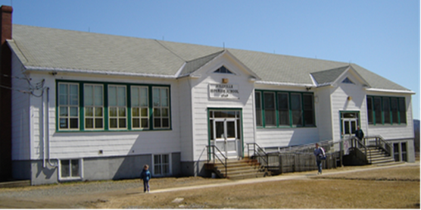
Thank you for coming!

